Slide 1


Impact of Science Conference the Plenary Session on:
Promoting Coherence About Impact Within the Science Eco-system
25th June, 2021

Slide 2
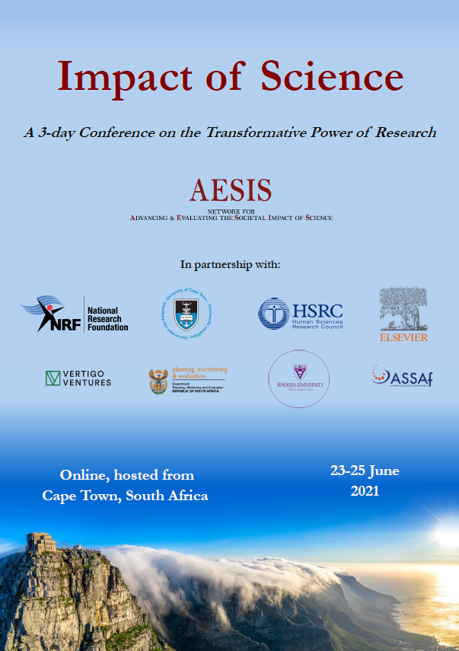

Impact of Science
23-25 June, 2021
Juliet Gerrard : Chief Science Advisor, Office of the Prime Minister, New Zealand
Ernest Aryeetey: Secretary-General of the African Research Universities Alliance (ARUA) and former Vice-Chancellor of the University of Ghana, Ghana
Toby Smith: Vice President for Policy at the Association of American Universities, USA
Daya Reddy: President of International Science Council, South Africa
Overview of the Speakers
#IOS21

Slide 3
Impact of Science
23-25 June, 2021
Ernest Aryeetey
Secretary-General of the African Research Universities Alliance (ARUA) and former Vice-Chancellor of the University of Ghana, Ghana
#IOS21

Slide 4

Promoting Coherence About Impact Within the Science Eco-System
Ernest Aryeetey
African Research Universities Alliance (ARUA)

Slide 5
Main Message
Promoting coherence about impact within the science eco-system is critical
  Measuring impact of science in Africa has not been properly understood and pursued
  Policies to implement/provide a coherent and inclusive science ecosystem should focus on promoting collaborative research, networking, good mentorship and providing funding
  Coordination of such policies would require the establishment of institutions to monitor and track progress.

Slide 6
Introduction
"Things do not (always) mean the same from everywhere; when we insist that only ‘our’ meaning is the meaning, we silence other people’s meanings” - Clapperton Mavhunga
Science has always played a very significant role in the world, with major impacts
  Science is responsible for: (1) the growing public awareness about the planet, (2) the economic expansion witnessed, (3) the transformation experienced in the world.
  Advances in science have resulted in new technologies for global communication and satellite images of the earth

Slide 7
How has science been presented in Africa? (1)
Science in Africa has generally been perceived as a western concept, and this includes our understanding of the social sciences
From the 15th – 16th Century, Africa assumed a “node in the emerging world economy’ (Sitas, 2014, p.466). Africa was studied, but differently by different people
  “… if a discipline could be said to possess a tap root, then research in Africa could be said to be a tap root of anthropology. It is virtually impossible to train as an anthropologist without having to take into account research conducted on the cultures of Africa.” (Bates et al, 1993)

Slide 8
How has science been presented in Africa? (2)
Wober observed that “the 1970s was predicted as the time when psychology in Africa [would turn] a corner, in that [the discipline would] be increasingly in the hands of new people, its own people, with their own outlooks, needs and direction of enquiry” (Wober, 1975).
Scientific research about Africa has shaped the concepts and methodologies employed in economics, history, political science, psychology
But participation by African researchers has been minimal

Slide 9
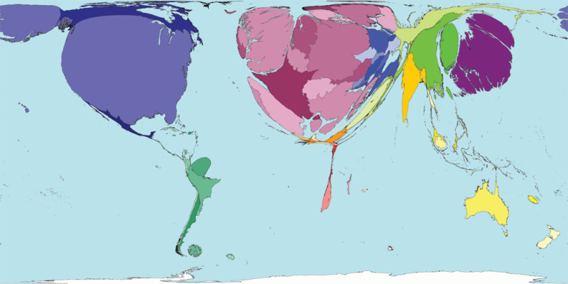
World Map Based on Scientific Research Produced

Slide 10
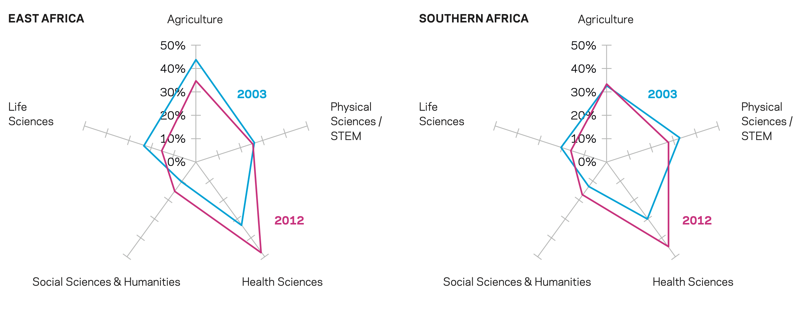
Percentage of total article output by subject grouping for SSA (2003 vs. 2012)
Source: worldbank.org/africa/stemresearchreport

Slide 11
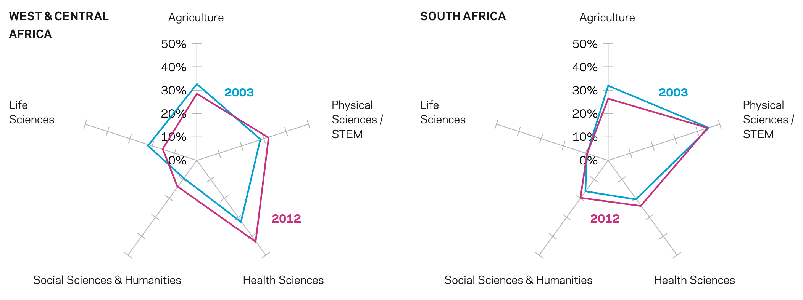
Percentage of total article output by subject grouping for SSA (2003 vs. 2012)
Research in the Health Sciences comprised the highest percentage in most African countries apart from South Africa
The Physical Sciences & STEM have been the main areas of focus for South Africa

Slide 12
How has science been presented in Africa? (3)
Average R&D expenditure in Africa has been consistently below 1% of GDP
Highest is for South Africa – 0.89% in 2006.
Scientists in South Africa are at the forefront of nanotechnology, astronomy, laser technology, and infectious diseases (HIV/AIDs, malaria, TB)

Slide 13
Promoting coherence about impact
There are necessary interventions at the regional, national and institutional levels
What impact is wished for in Africa? What changes do Africans want? Promoting coherence about impact within the science eco-system is critical to ensuring knowledge creation in the region significantly increases, and is useful. It amounts to
  Promoting consistency
  Ensuring no country is left behind
  Encouraging innovation and new technology adoption
  Fostering synergies across disciplines
  Addressing the gap between Higher Education Institutions and development issues on the continent

Slide 14
What policies are required to implement/provide a coherent and inclusive science ecosystem?
Hardly any African country is in a position to build a strong, self-contained science ecosystem
Policies must focus on providing/promoting
  Joint/collaborative research
  Networking amongst universities
  Good mentorship at the postgraduate level
  Providing adequate funding for research
  Promoting links between universities and academia
  An overarching emphasis on STEM

Slide 15
How policies can be coordinated to achieve coherence (Region)
Significant investment in infrastructure (especially those related to STEM) within African universities to facilitate collaboration
Tracking of progress; e.g., the Higher Education Research and Advocacy Network in Africa (HERANA) project
Establishing Centres of Excellence around critical issues in Africa; e.g., ARUA and World Bank (interdisciplinarity)

Slide 16
How policies can be coordinated to achieve coherence (Governments)
The role of national governments needs to be clearly defined and there should be adequate commitment
  National governments need to be more ambitious about using local knowledge to transform economies and societies
  They must be willing to prioritise investments in research
  They must demand results for their investments
  They can guide useful competition and collaboration with proper incentives and guidelines

Slide 17
How policies can be coordinated to achieve coherence? (HEIs)
Higher Education Institutions need to change to reflect on rigour and relevance for impact
Establishing units to manage research within universities. E.g. Office for Research, Innovation and Development (ORID) at the University of Ghana
  Developing and implementing research policy
  Fund-raising for research
  Setting standards for research and information dissemination
  Registration, patenting and commercialization of intellectual property

Slide 18
Conclusion
Promoting coherence about impact of science requires governments and their research systems to work across national borders
African researchers need to work across disciplines
African researchers need to think about both relevance and rigour in order to have impact

Slide 19
Impact of Science
23-25 June, 2021
Toby Smith
Vice President for Policy at the Association of American Universities, USA
#IOS21

Slide 20

Promoting coherence about impact within the science eco-system
Tobin L. Smith, Association of American Universities
Impact of Science 2021 South Africa
25 June 2021

Slide 21
What is Needed to Promote Coherence About Impact within the Science Eco-System
Understanding what is meant by ‘impact’
Framework(s) for assessing impact
Developing accompanying impact data, metrics, assessment, and evaluation tools and infrastructure
Re-examining what constitutes ‘excellence’ in the science eco-system and how we evaluate, recognize, and reward it within universities

Slide 22
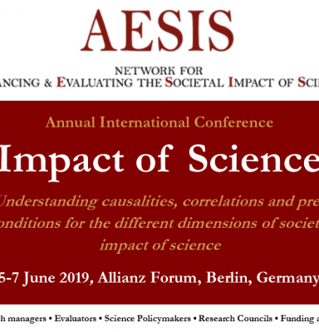
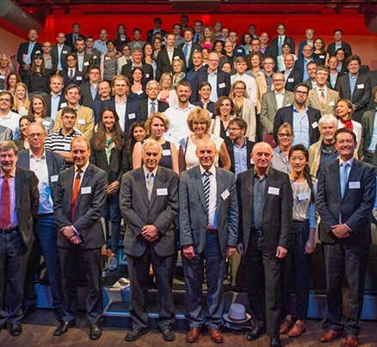
Challenges with Developing a Shared Definition
Difference between scientific and societal impact
Quantitative vs. qualitative
Direct vs. indirect impacts
Economic vs. social
Retrospective vs. prospective
Ultimately, how you define impact depends on who you are and what matters to you!

Slide 23


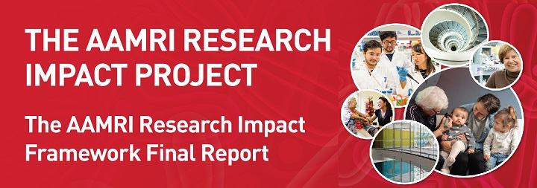
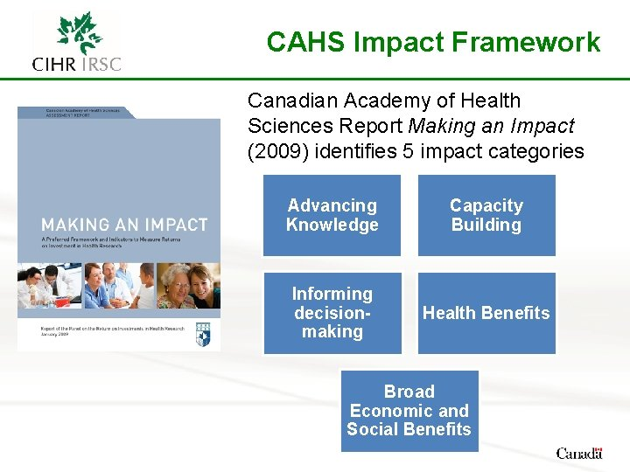


Frameworks for Assessing Impacts
Basic
Research
Applied
Research
Development

Slide 24
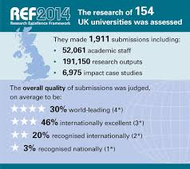


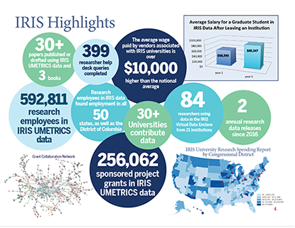
Data vs. Case Studies vs.
Impact Plans
Retrospective vs. Prospective
Notes:
Where we’ve been
Where we are
And Where we are going
Let me take just a few moments to remind all of us what we were thinking in January

Slide 25
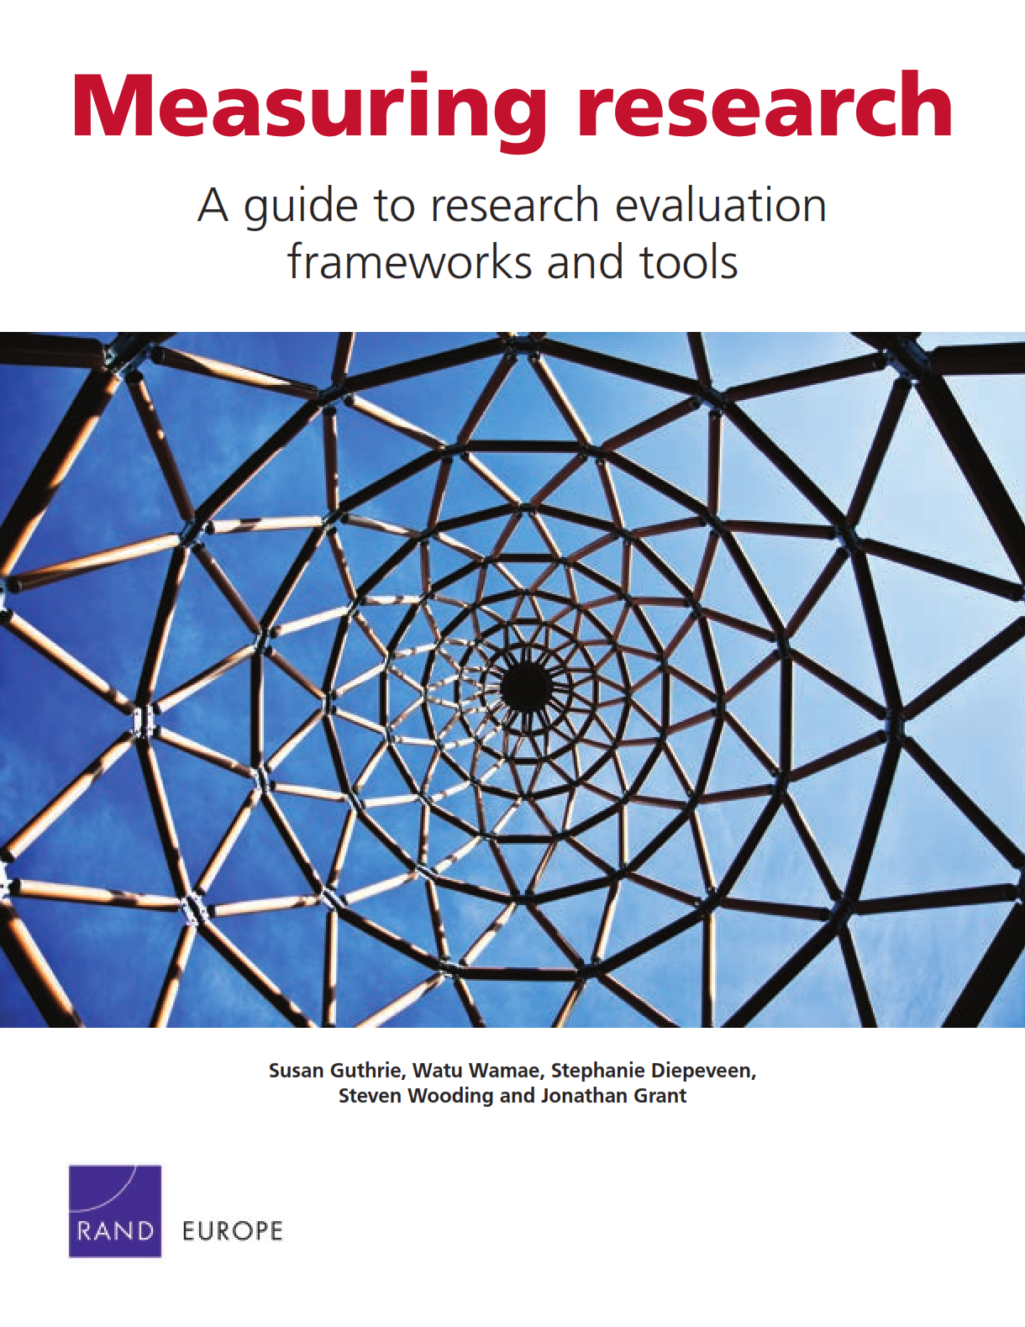
Value of a Framework
Develops common language and understanding
Helps organize information and concepts
Provides shared definitions
Helps determine appropriate impact metrics and indicators
Can help communicate scientific impact to outside stakeholders

Slide 26
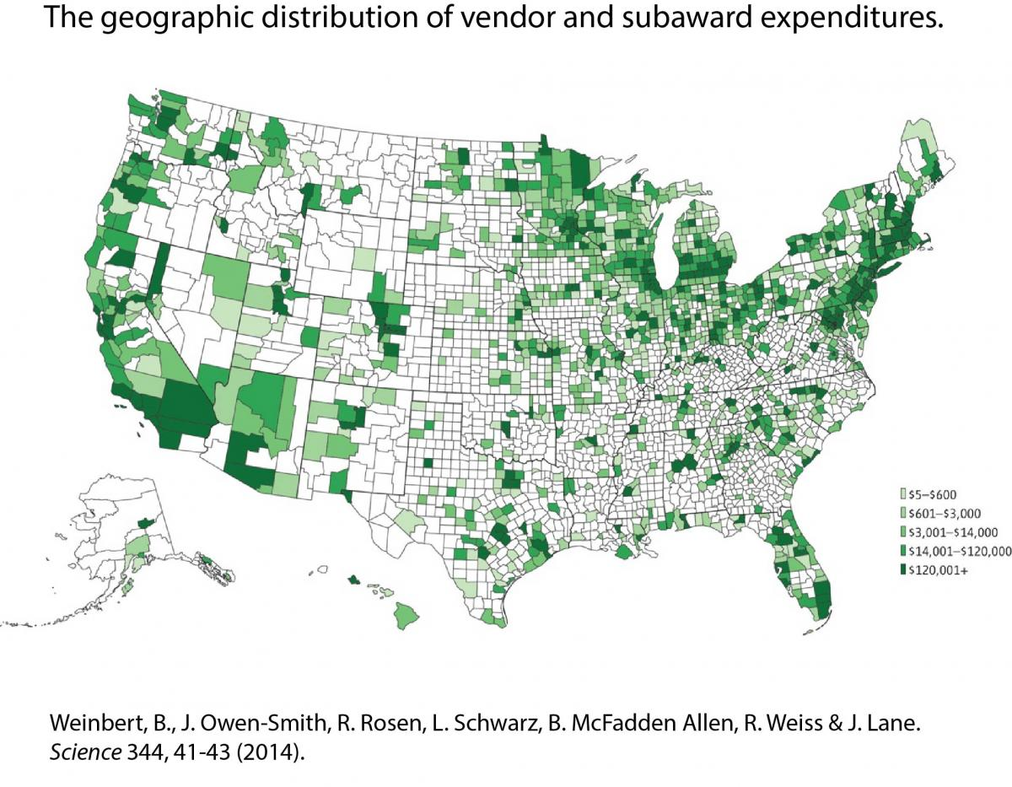
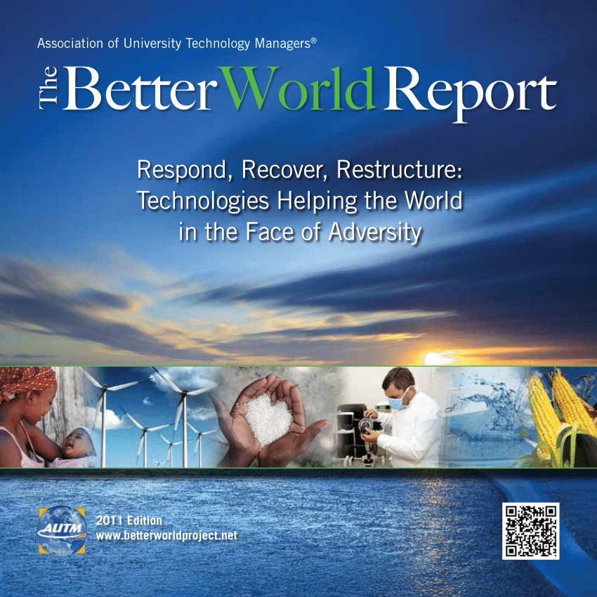
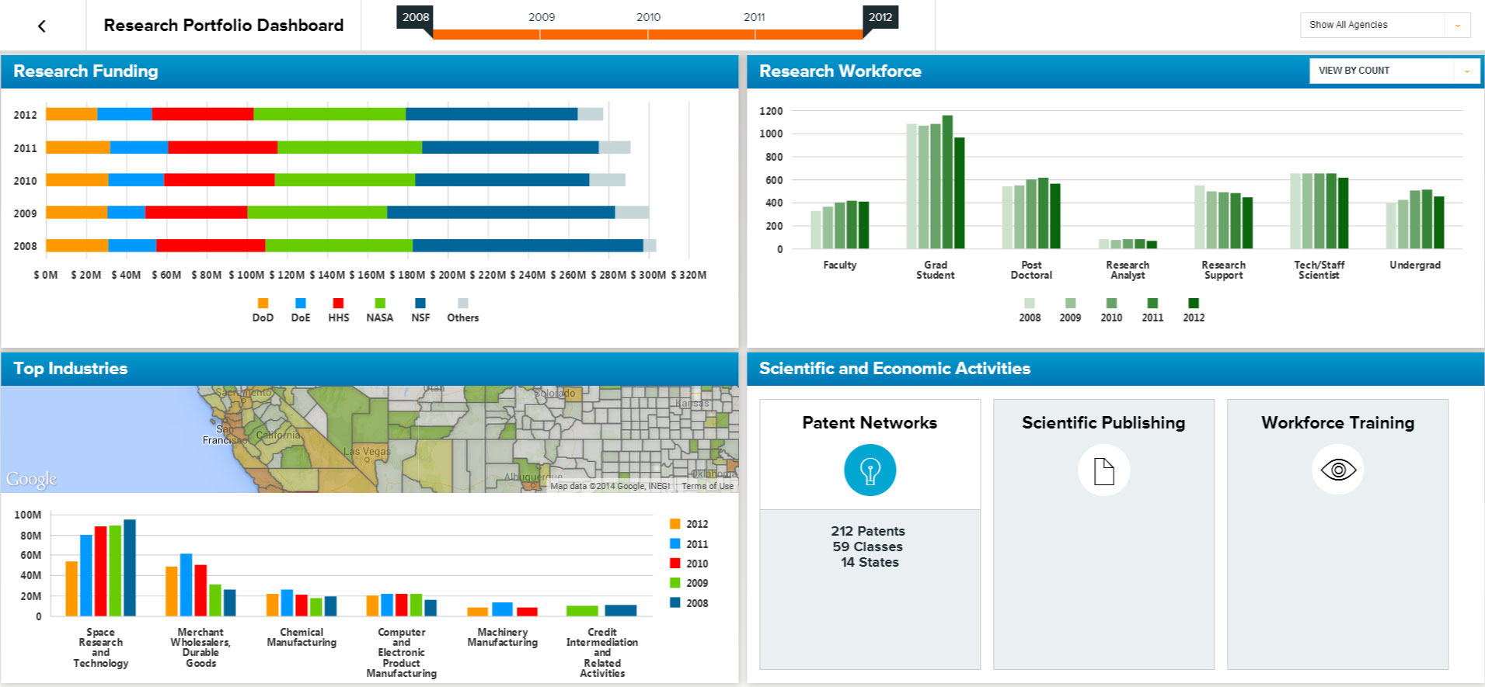
Data, Metrics, Assessment and Evaluation Tools
Bibliometrics
Economic analysis
Patent analysis
Case studies
Peer review
Data mining
Surveys/Interviews
Data Visualization
Site Visits
Document Review

Slide 27

Stakeholders: Who are they and what do the care about?
Who: researchers, policymakers, and the public. Who are the others?
How does each view impact?
Are there ways you can determine and assess this?
  AAU Public Opinion Polling Initiative
Once you know, what are your best metrics and communications strategies?

Slide 28
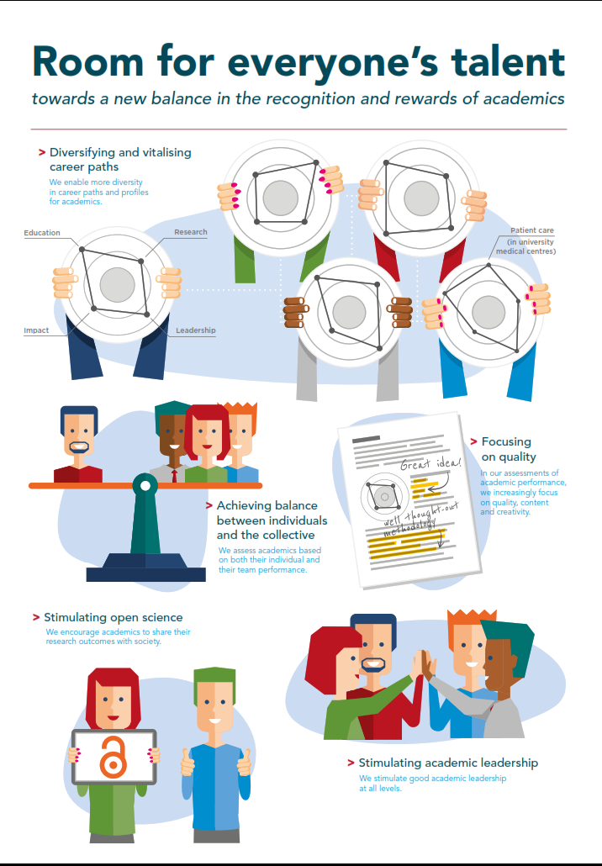
Reassessing What “Excellence” and “Impact” Means at Universities
Dutch “Room for Everyone’s Talent”
Reassesses how university faculty are evaluated, recognized, and rewarded
Seeks to find a balance between the individual success and contributions to the collective
Less focused on quantitative assessment of research and more on quality of work and contribution to scientific, educational, and societal impacts
Hope is to broaden faculty career paths and diversity and to stimulate open science and academic leadership
How do we assess impact of academic units/departments and what constitutes excellence and impact at that level?

Slide 29
“Many academics feel there is a one-sided emphasis on research performance, frequently leading to the undervaluation of the other key areas such as education, impact, leadership and (for university medical centers) patient care."

Slide 30




Contact Me
toby.smith@aau.edu
@SciPolGuy
@AAUniversities
www.aau.edu

Slide 31
Impact of Science
23-25 June, 2021
Daya Reddy
President of International Science Council, South Africa
#IOS21

Slide 32

Promoting coherence about impact in the science eco-system
Daya Reddy
President
International Science Council (ISC)
Impact of Science, AESIS Cape Town, 23 – 25 June 2021

Slide 33
What policies are required by different organisations and insititutions in order to implement and provide a coherent and inclusive science eco-system that allows transformative and impactful research in society? And how can these policy perspectives be coordinated to achieve coherence?
Coherence
Harmonization of efforts, actions and assumptions Forming a unified or integrated whole
Systematic, consistent and logical connections
The science eco-system includes
Scientists, individual and groups
Research and higher education institutions
The private sector
Policymakers and intergovernmental bodies
Scientific unions, academies – local, regional, global
Funders and donors
Civil society organizations
Publishers, journals

Slide 34
The contemporary context for science

Slide 35

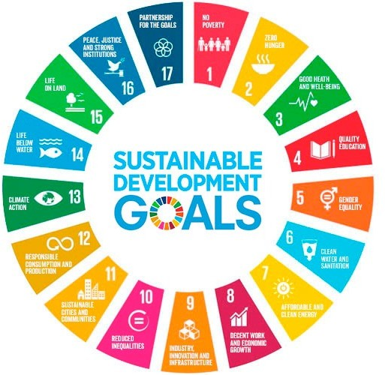


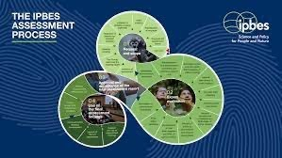


Major challenges faced by humanity and the planet
Paris Agreement UN Framework Convention on Climate Change (UNFCCC)
NEW URBAN AGENDA
Sendai Framework
for Disaster Risk Reduction 2015 - 2030

Slide 36



The devastating impact of the Covid-19 pandemic
It took just nine months for the fortunes of the top 1,000 billionaires to return to their pre-pandemic highs, while for the world’s poorest, recovery could take more than a decade.
The inequality virus
exposing fallacies and falsehoods everywhere: The lie that free markets can deliver healthcare for all; The fiction
that unpaid care work is not work; The delusion that we live in a post-racist world; The myth that we are all in the same boat. While we are all floating on the same sea, it’s clear that some are in super yachts, while others are clinging
to the drifting debris.’ – Antonio Guterres, UN Secretary General¹
‘COVID-19 has been likened to an x-ray, revealing fractures in the fragile skeleton of the societies we have built. It is
COVID-19 MAY LEAD TO AN INCREASE IN INEQUALITY IN ALMOST EVERY
COUNTRY AT ONCE, THE FIRST TIME SINCE RECORDS BEGAN.
FEBRUARY
100%
MARCH
70.3%
NOVEMBER
99.9%
change in top 1,000 billionaires’ wealth (2020)
OXFAM Briefing Paper, Jan. 2021

Slide 37


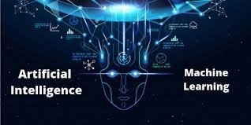
Major scientific and technological advances
Gene and genome editing
Big Data
hackr.io
bernardmarr.com

Slide 38

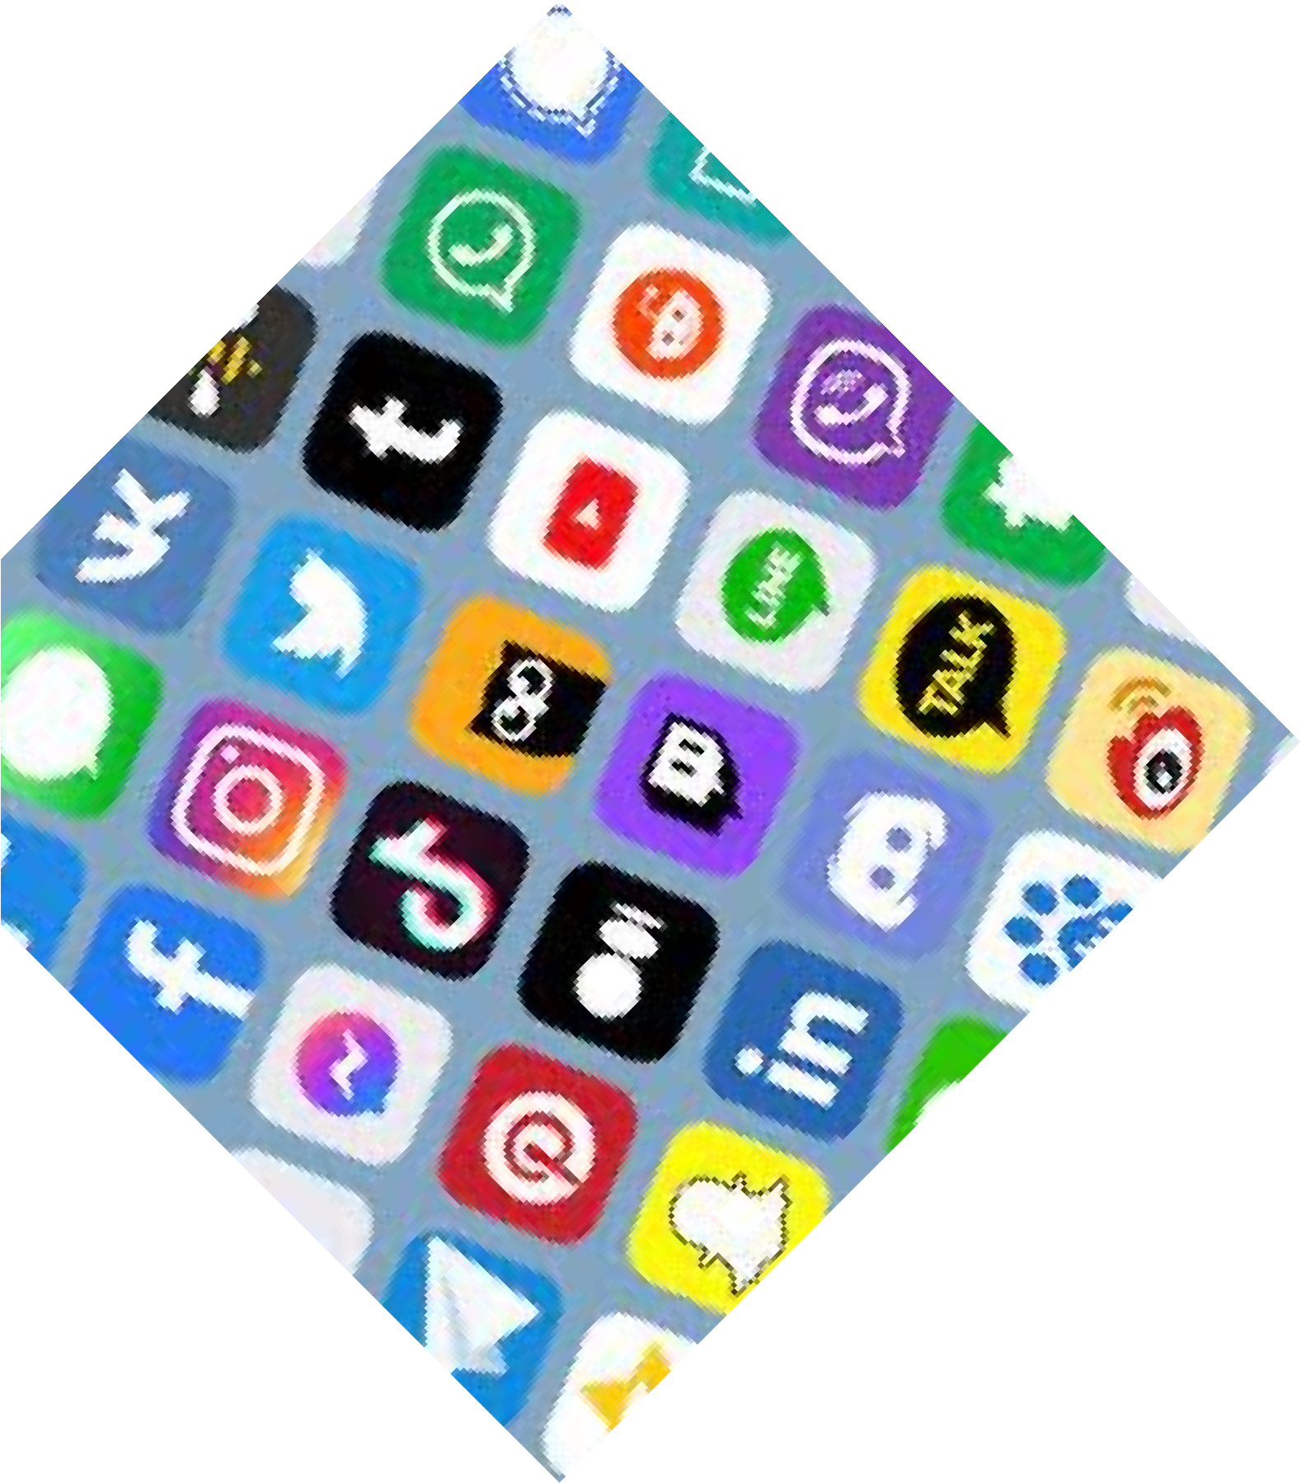

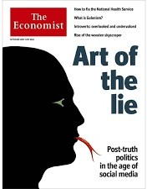
The new information age
‘Infodemic of information, radical growth in access to information (unequally)
Spread of misinformation, pseudo-scientific views
Doubt cast on the need for scientific understanding
Challenges to the scientific consensus
Lack of supporting evidence, erroneous arguments

Slide 39
Policies shaped by principles, values, responsibilities, priorities
Inform strategies, and practices

Slide 40
Some key domains of priority
Inclusive cooperation Open science Research assessment
. . . . . . . . .

Slide 41
Inclusivity and cooperation
Science thrives in a cooperative environment
Setting the scientific agenda: how, with whom: across disciplines, sectors, borders, cultures
Inclusivity, real partnerships: reflect local contexts and capabilities, customize pathways of future development
Transdisciplinary thinking, while maintaining healthy disciplines
“Standing on the shoulders of crowds” (Nature, June 2021)

Slide 42
What to do?
Academies, scientific unions, global bodies - active steps to ensure real inclusivity within their memberships
Universities: remove barriers to multidisciplinary teaching and research
Work with funders to strengthen capacity and so enable full partnerships
Research labs, civil society orgs, universities, funding bodies – work towards shaping research programmes collectively

Slide 43



What to do?
Global scientific bodies have a special role to play, given their convening and mobilizing power
Able to coordinate among members, between orgs, and at the science-policy interface

Slide 44

Open Science
Open data Open access publishing
Open engagement with society
Powerful basis for inclusive development and cooperation
Greater sharing of ideas
Failure to effect real openness will exacerbate divides between Global North and Global South
Major responsibility for funding councils, publishers, research bodies, libraries, … to coordinate strategies and their implementation

Slide 45


Scientific and diplomatic collaboration at regional level: The African Open Science Platform
African scientists at the cutting edge of contemporary, data-intensive science as a fundamental resource for a modern society
Platform Forum
Coordination
Flagship
Co-Designed Data Intensive Projects
Government
Priority setting
Funders Funding Incentives
Shared investment in infrastructure
Capacity Building
Training and Skills

Slide 46
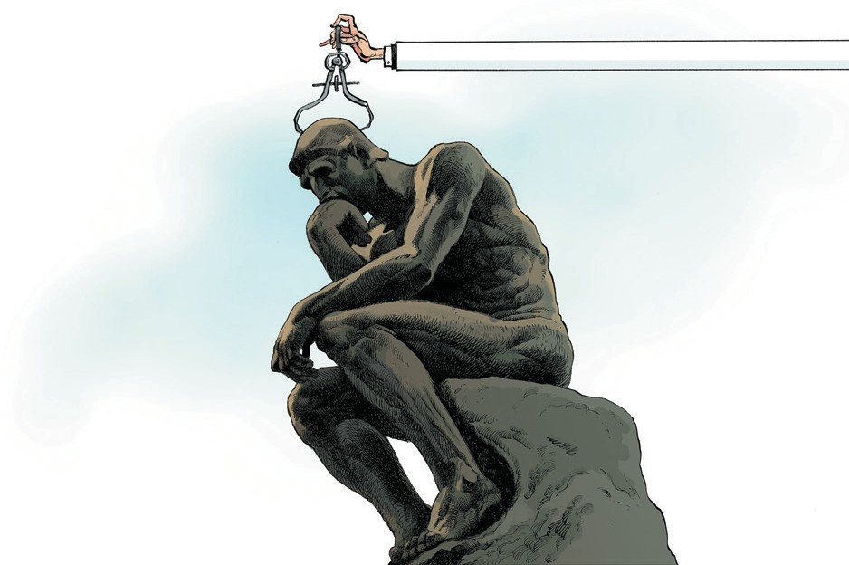

Policy for science: Assessment and Evaluation of Research
Problematic use of proxy measures of research impact
Need for review of assessment, e.g. in recruitment, promotion, grant applications Reward and recognition of work having high societal impact
Requires collaboration among almost all sectors in the science eco-system
The Leiden Manifesto for research metrics
Use these ten principles to guide research evaluation, urge Diana Hicks, Paul Wouters and colleagues.
ISC, IAP and Global Young Academy working towards review of systems in use, and implementable best practice recommendations

Slide 47
The list is incomplete …
Coordinated efforts and coherence priorities also in relation to
Public engagement and communication
The private sector
……

Slide 48







@ISC
/InternationalScience
International Science Council
/council.science
c/InternationalScienceCouncil
/c/GlobalScienceTelevision

Slide 49
Impact of Science
23-25 June, 2021
The rest of the speakers chose not to use any presentations, please find the recordings available on the platform
#IOS21

Slide 50
Impact of Science
23-25 June, 2021
Thank you
#IOS21

